Slide 1
Body language
Please number 1 - 10 in your notebook.
Look at the picture.
Write P if the message is Positive.
Write N if the message is Negative.
Write U for Uncertain.

Slide 2
1.

Slide 3
2.

Slide 4
3.
( Look at the woman. )

Slide 5
4.
(Look at the blonde woman.)

Slide 6
5.
(Look at the woman holding the pen.)

Slide 7
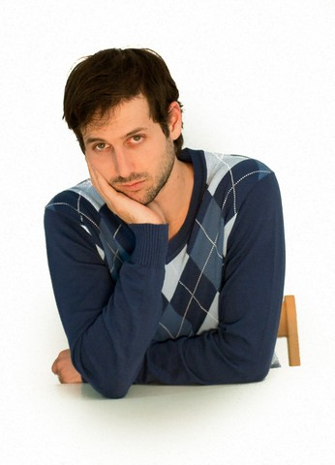
6.

Slide 8
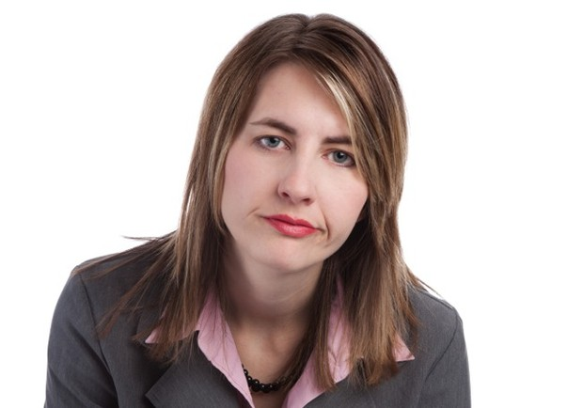
7.

Slide 9
8.
(Look at the woman.)

Slide 10
9.
(Look at the woman.)

Slide 11
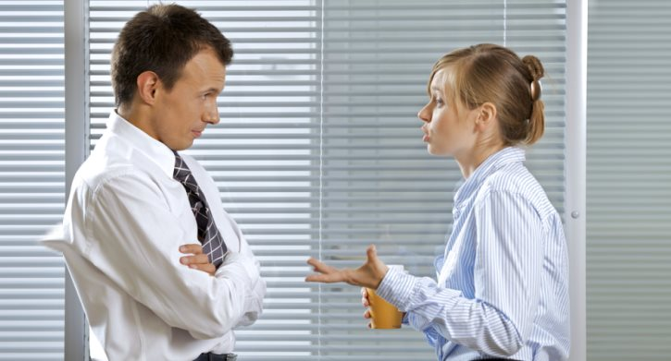
10.
(Look at the man.)

